Slide 2
Building Progressive Web Apps for Windows
Jeff Burtoft
BRK2428

Slide 3











A PWA is
Progressive
Works on any device and enhance functionality progressively.
Performant
Works as fast or faster than a native app.
Linkable
Ability to retain or reload its state and be shareable from a link.
Responsive
Fit any device’s form factor and screen size.
App-like
Looks like a native app and uses the application shell model with minimal page refreshes.
Connectivity-agnostic
Works with low connectivity or offline.
Installable
Install on the device’s desktop, start menu, or task bar making it readily available.
Current
Application and content is up to date when connected to the Internet.
Re-engageable
Promotes re-engagement through features such as push notifications.
Discoverable
Better discovery and integration with search.
Connected to users
Direct feedback to you through ratings and reviews
Notes:
We hear about benifits to building a PWA from developers, next slides will dig into the benifts for you

Slide 4
Why PWA?
Our Goal: The very best experience for your Web content will be on Windows

Slide 5
Keep your workflow for web
Deploy
The work flow for web and PWAs are shared, so your deploy process doesn’t need to change to accommodate PWA.
Build
Deploy
Web Content
Publish App
Web
The same app runs across browsers and can take advantage of PWA features as needed / supported.
PWA
The same app serve as a store app with even more features and additional reach to store users.
Build
Build with web technology and web developers. No need to find and hire c# developers.
Publish App
Your PWA “app container” needs only to be published once. The content is always up to date because it comes from the web.
Notes:
We are not asking you to do anything different. This is maintained just like your website. There is a one time publish to the windows store

Slide 6


















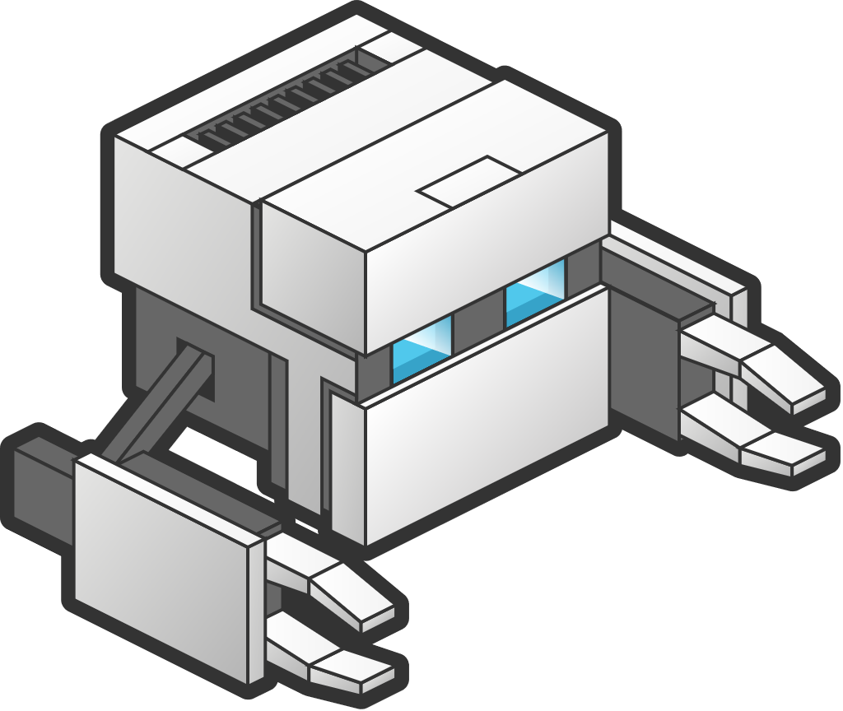




















Large Ecosystem of frameworks
Notes:
Avoid bulleted lists! Provide a visual for it :-) Animated

Slide 7



CROSS PLATFORM
X
PROGRESSIVE
WEB APPS
Devices + IoT
Mobile
PC
Xbox
Surface Hub
HoloLens
ACROSS WINDOWS
Notes:
In every modern browser on every platform, Edge, Windows 10, Chrome, Chrome OS, Android, Firefox, Safari, iOS, MacOS

Slide 8
Minimum Viable Progressive Web App
HTTPS
Web App Manifest
Service Worker

Slide 9
Web Application Manifest
{
"lang": "en",
"short_name": "Wash Post",
"name": "The Washington Post",
"icons": [
{
"src": "img/launcher-icon-2x.png",
"sizes": "96x96",
"type": "image/png"
},
{
"src": "img/launcher-icon-4x.png",
"sizes": ”512x512",
"type": "image/png"
}
],
"start_url": "/pwa/?utm_source=homescreen",
"display": "standalone",
"orientation": "portrait",
"background_color": "black"
}

Slide 10
Web Application Manifest
{
"lang": "en",
"short_name": "Wash Post",
"name": "The Washington Post",
"icons": [
{
"src": "img/launcher-icon-2x.png",
"sizes": "96x96",
"type": "image/png"
},
{
"src": "img/launcher-icon-4x.png",
"sizes": ”512x512",
"type": "image/png"
}
],
"start_url": "/pwa/?utm_source=homescreen",
"display": "standalone",
"orientation": "portrait",
"background_color": "black"
}

Slide 11
Web Application Manifest
{
"lang": "en",
"short_name": "Wash Post",
"name": "The Washington Post",
"icons": [
{
"src": "img/launcher-icon-2x.png",
"sizes": "96x96",
"type": "image/png"
},
{
"src": "img/launcher-icon-4x.png",
"sizes": ”512x512",
"type": "image/png"
}
],
"start_url": "/pwa/?utm_source=homescreen",
"display": "standalone",
"orientation": "portrait",
"background_color": "black"
}

Slide 12
Web Application Manifest
{
"lang": "en",
"short_name": "Wash Post",
"name": "The Washington Post",
"icons": [
{
"src": "img/launcher-icon-2x.png",
"sizes": "96x96",
"type": "image/png"
},
{
"src": "img/launcher-icon-4x.png",
"sizes": ”512x512",
"type": "image/png"
}
],
"start_url": "/pwa/?utm_source=homescreen",
"display": "standalone",
"orientation": "portrait",
"background_color": "black"
}

Slide 13
App display Property
Browser
Standalone UI
Minimal UI
Next version of Windows
Runs in Edge as a separate windows or Tab.
Full browser UI, no store listing
Runs in App container in separate process.
No browser UI, back button only.
Microsoft store listing
Runs in App container in separate process.
Limited UI (navigation & read only nav bar).
Microsoft store listing

Slide 14
Network request: Typical
Web App
Network
Notes:
This represents a typical network request

Slide 15


Network request: Service Worker in play
Web App
Service Worker
Network
Cache
Notes:
It can even go to the network and then store a copy for later

Slide 16
Step 1: Register a Service Worker
if ( navigator.serviceWorker ) {
if ( navigator.serviceWorker.controller ) {
console.log('There’s an active service worker');
} else {
navigator.serviceWorker.register('/sw.js')
.then(function(reg) {
console.log('SW registered for scope', reg.scope);
}); }
}

Slide 17
Step 1: Register a Service Worker
if ( navigator.serviceWorker ) {
if ( navigator.serviceWorker.controller ) {
console.log('There’s an active service worker');
} else {
navigator.serviceWorker.register('/sw.js')
.then(function(reg) {
console.log('SW registered for scope', reg.scope);
}); }
}
This tests to see if Service Workers are supported.

Slide 18
Step 1: Register a Service Worker
if ( navigator.serviceWorker ) {
if ( navigator.serviceWorker.controller ) {
console.log('There’s an active service worker');
} else {
navigator.serviceWorker.register('/sw.js')
.then(function(reg) {
console.log('SW registered for scope', reg.scope);
}); }
}
We can also see if there’s a Service Worker already running.

Slide 19
Step 1: Register a Service Worker
if ( navigator.serviceWorker ) {
if ( navigator.serviceWorker.controller ) {
console.log('There’s an active service worker');
} else {
navigator.serviceWorker.register('/sw.js')
.then(function(reg) {
console.log('SW registered for scope', reg.scope);
}); }
}
If there isn’t, we can register one.

Slide 20
Step 1: Register a Service Worker
if ( navigator.serviceWorker ) {
if ( navigator.serviceWorker.controller ) {
console.log('There’s an active service worker');
} else {
navigator.serviceWorker.register('/sw.js')
.then(function(reg) {
console.log('SW registered for scope', reg.scope);
}); }
}
By default, a Service Worker is scoped to its path.

Slide 21
Step 2: Start manipulating requests
addEventListener('fetch', function(evt) { evt.respondWith(
fromCache(evt.request)
.catch(fromServer(evt.request)));
evt.waitUntil(update(evt.request));
});

Slide 22
Step 2: Start manipulating requests
addEventListener('fetch', function(evt) { evt.respondWith(
fromCache(evt.request)
.catch(fromServer(evt.request)));
evt.waitUntil(update(evt.request));
});
In a Service Worker we can intercept any network requests (“fetch”).

Slide 23
Step 2: Start manipulating requests
addEventListener('fetch', function(evt) { evt.respondWith(
fromCache(evt.request)
.catch(fromServer(evt.request)));
evt.waitUntil(update(evt.request));
});
And we can control the response. In this case responding from the cache first.

Slide 24
Step 2: Start manipulating requests
addEventListener('fetch', function(evt) { evt.respondWith(
fromCache(evt.request)
.catch(fromServer(evt.request)));
evt.waitUntil(update(evt.request));
});
If no cached response is found, we can go to the network.

Slide 25
Step 2: Start manipulating requests
addEventListener('fetch', function(evt) { evt.respondWith(
fromCache(evt.request)
.catch(fromServer(evt.request)));
evt.waitUntil(update(evt.request));
});
We can also update the cache for the next time the request is made.

Slide 26
Demo: PWA “display” & “theme” property
Target delivery for RS5

Slide 27
PWAs in the Microsoft Store

Slide 28

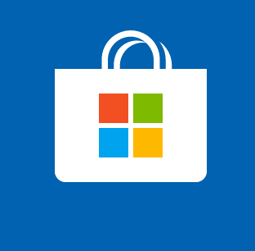
Getting Into the store
Auto Indexing
Self Publishing
Bing Discovers PWAs on the Web and are automatically reviewed and listed into the store
Developer opens a dev account for the Microsoft Store and publishing app under dev name.

Slide 29
How to get Auto Indexed
HTTPS, secure endpoint
High quality manifest (names, screen shots, descriptions)
Offline functionality
Pass store certification
Does not sell digital goods
Does not contain adult content
No offensive content
Looking for Windows differentiators

Slide 30

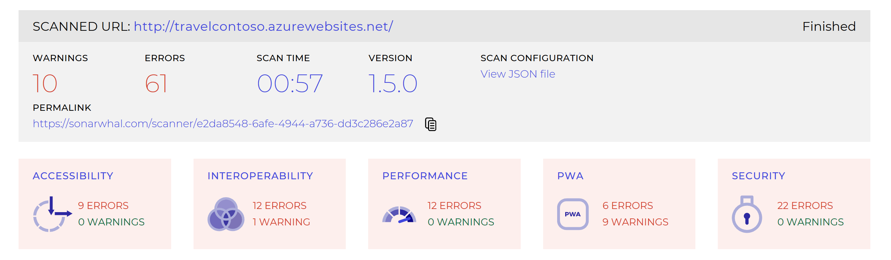
Validate your PWA is ready for Microsoft Store
Improve perf and User Experience

Slide 31
Sonarwhal
PWA readiness
https://sonarwhal.com/scanner/e2da8548-6afe-4944-a736-dd3c286e2a87

Slide 32
How to NOT get published
No manifest, no https or no offline capability
Robot.txt file telling Bing to ignore manifest
Display: browser
Service request to store to remove app (reportapp@microsoft.com)
😪

Slide 33
Taking ownership of App
Open a dev account at dev.microsoft.com
Show ownership of web app
Request transfer to reportapp@microsoft.com

Slide 34
NEW Nominate an App for Discovery
TBD

Slide 35

Self Publishing of App
Open / Maintain active Dev center Account
Adhere to Microsoft Store policies
Generate Appx with VS, pwabuilder CLI, or on PWABuilder.com

Slide 36
Get started on PWA with PWABuilder
Tooling in Command Line and pwabuilder.com
Build Manifest from current Web Site along with image generation
Choose from a selection of base Service Workers that handle simple offline capabilities
Generate Appx for Windows 10
Generate store packages for other platforms
Get started with Windows APIs

Slide 37
Build an Appx for PWA with PWABuilder.com

Slide 38
PWAs on Windows: Awesomeness

Slide 39
Value Add of Windows Store App
Dev Center analytics
In app Purchases
Promotability
No Data Storage Caps
Service Workers
Windows API access

Slide 40
Value Add of Windows Store App
Dev Center analytics
In app Purchases
Promotability
No Data Storage Caps
Service Workers
Windows API access

Slide 41
Value Add of Windows Store App
Dev Center analytics
In app Purchases
Promotability
No Data Storage Caps
Service Workers
Windows API access

Slide 42
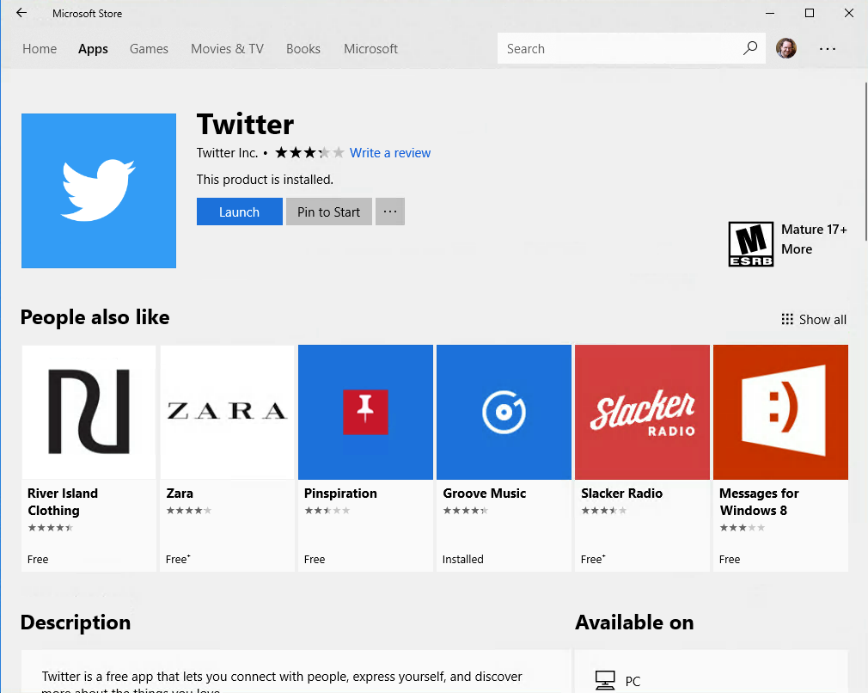

Slide 43
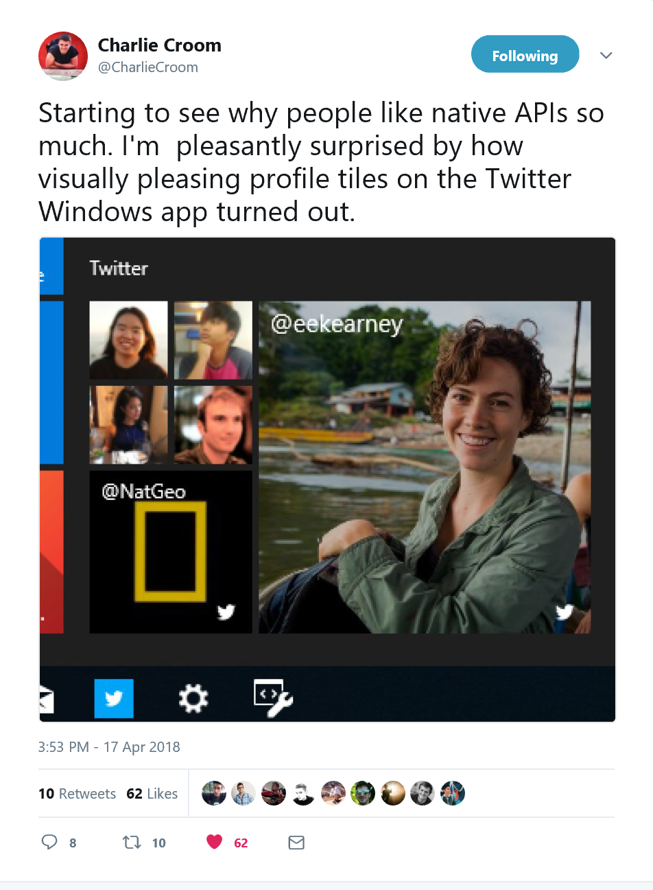

Slide 44
Access OS-level APIs Dark theme
// Am I installed in Windows? if ( window.Windows ){ // Change the theme var uiSettings = new Windows.UI.ViewManagement.UISettings();
var color = uiSettings.getColorValue(
Windows.UI.ViewManagement.UIColorType.background
if(color.b === 0){
document.body.classList.add('dark')
};
}

Slide 45
Access OS-level APIs Share API
// Am I installed in Windows? if ( window.Windows ){ const dataTransferManager = Windows.ApplicationModel.DataTransfer.DataTransferManager.getForCurrentView();
dataTransferManager.addEventListener("datarequested", handleShareEvent);
//show the share dialogue
Windows.ApplicationModel.DataTransfer.DataTransferManager.showShareUI();
}
https://gist.github.com/comp615/a1c794dbcfa94a6ee051ff938766bfbd (thanks Charlie!)
Notes:
Talk about standar and mapping when standard is

Slide 46
Access OS-level APIs Secondary Pinning
// Am I installed in Windows? if ( window.Windows ){ // pin a secondary tile tile = new Windows.UI.StartScreen.SecondaryTile(tileId, text, text, activationArguments,newTileDesiredSize, logoUri);
//place activation
var buttonCoordinates = { x: SR.left, y: SR.top, width: SR.width, height: SR.height };
var placement = Windows.UI.Popups.Placement.above;
}

Slide 47
PWA Activation Object launch event
// Am I installed in Windows? document.AddEventListiner ( 'activated' function(e){
if(e.eventParamter.activated.value){
//activation value passed
}
})

Slide 48
Calling Windows APIs
Pwabuilder.com/windows

Slide 49
Building Twitter PWA

Slide 50
PWA with a splash of native

Slide 51
Calling C# / C++ from PWA
PCL or Custom WinRT object which has been “allowed for Web”
Package PWA in Visual Studio (for now)
Classes Exposed in DOM as native JavaScript object
Used for
Code reuse
Calling non-accessible APIs
Performance

Slide 52
Calling C# from a webview
namespace CommunicationWinRT
{
[Windows.Foundation.Metadata.AllowForWeb]
public sealed class CommunicationWinRT
{
public CommunicationWinRT()
{
}
public String GetValue()
{
return "From my WinRT component Yo!";
}
}
}

Slide 53
Calling C# from a webview
document.getElementById('toast').addEventListener('click', function () {
if (window.CommunicationWinRT) {
testToast.toastMessage(document.getElementById('input').value, 0)
} else {
alert(document.getElementById('input').value)
}
})
if (window.CommunicationWinRT) {
var testToast = new CommunicationWinRT.CommunicationWinRT();
}

Slide 54
Calling C# from a PWA

Slide 55
RS5 & beyond

Slide 56
Enhance the Service Worker
Periodic Sync
Push Notifications
User Experience
One-off Sync
Offline
Less Network Reliance
Site
Capabilities
Notes:
Service workers even have their own levels of enhancement. And more will come with time, like background sync.

Slide 57
Service Worker calling WinRT APIs
addEventListener('fetch', function(evt) { evt.respondWith(
fromCache(evt.request)
.catch(fromServer(evt.request)));
evt.waitUntil(function(evt.request){
Windows.Storage.AccessCache.StorageApplicationPermissions
.futureAccessList.add(evt.request);
});
});
Notes:
Make sure the cache is up to date

Slide 58
Shared cookies / cache

Slide 59
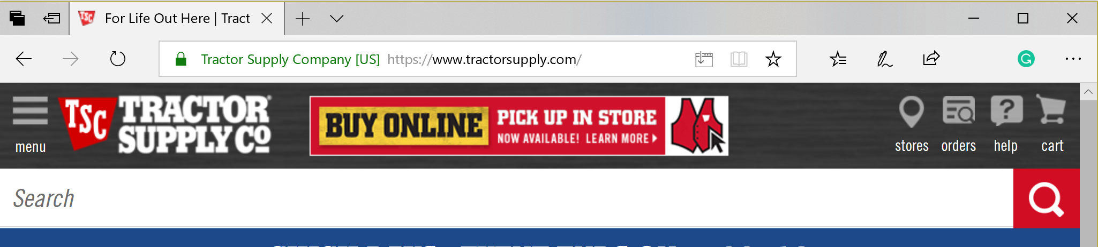
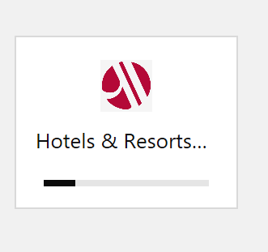
Install from Browser

Slide 60
Remember
PWAs are part of Windows to enable Web developers to build great user experiences.
PWAs can naturally or specifically be added to the Microsoft store.
PWAs are powerful, flexible and extensible on Windows.
We’re not done yet!

Slide 61
Additional Sessions BRK2404 Tuesday 3:00PM Building performant and re-engaging web apps with Service Worker THR2407-1 Tuesday 2:00PM Amazing experiences and how to build them – from the people building showcases and demos

Slide 62
Thank you. @boyofgreen @MSEdgeDev PWABuilder.com

Slide 63
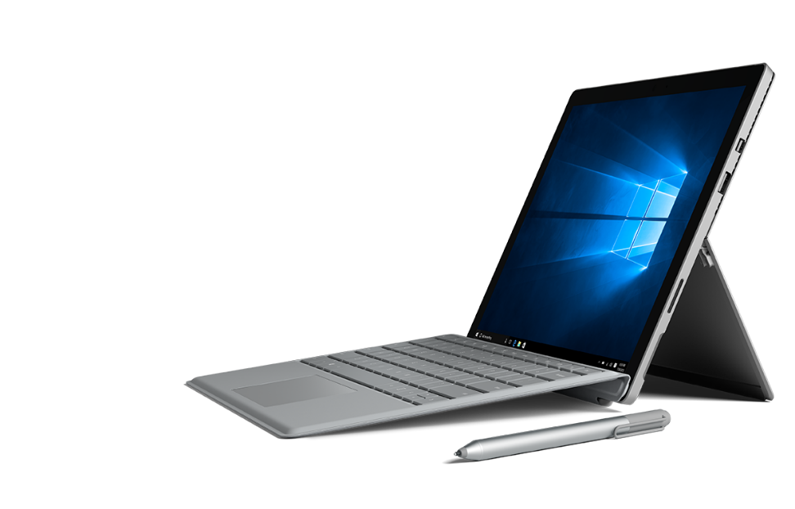
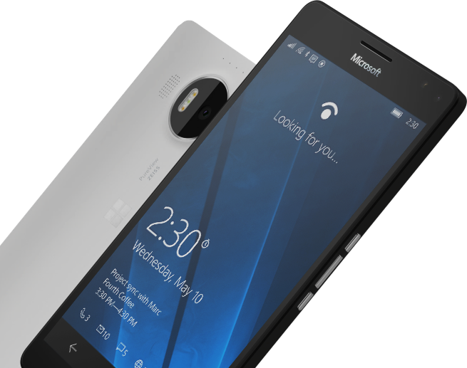
Please Complete An Evaluation Form for every session you attend. Your input is important! BRK2428
#MSBuild

Slide 65
Slide palette info
The PowerPoint palette for this template has been built for you and is shown below.
Avoid using too many colors in your presentation.
PowerPoint Theme Accent colors
Accent 1
Accent 2
Accent 3
Accent 4
Accent 5
Accent 6
Use Accent 1 as the main accent color.
Use Accent 2 and Accent 3 only when additional colors are needed.
Use Accents 4-6 sparingly

